Slide 1
2D Physics and Camera Systems
For CSE 3902
Updated By: Neil Kirby

Slide 2
Outline
2D game physics
Terms
Equations
Updating position and velocity
Scrolling cameras
Graphics pipeline
Transforming between coordinate systems

Slide 3
2D Game physics

Slide 4
Physics of motion terms
Position – vector indicating the location of a point relative to the coordinate system origin
Velocity – the rate of change of the position of an object in a direction [vector]
Acceleration – the rate at which the velocity of an object changes with time [vector]

Slide 5
Sidebar on Vectors
Vectors have magnitude
Vectors have direction
Sometimes direction is implied. “velocity in x” takes care of direction, leaving only the magnitude as the number
All vector quantities in your code should carry direction or imply that direction

Slide 6
Physics of motion equations
No acceleration
a
m
f
Constant acceleration
v’
v
vave
a

Slide 7
Position update code
Assuming controls modify the velocity of an object, its position Update is:
position += velocity * dt,
where dt is the amount of time passed since the last Update (set manually or via GameTime) and direction is accounted for

Slide 8
Friction and damping
With no other accelerations, velocity will only change based on user input
To slow objects down without acceleration, as part of update:
velocity *= speedDecayRate,
where 0 < speedDecayRate < 1

Slide 9
Clamping
Keeping a value within a specified range
Prevent objects from moving off-screen
Prevent objects from moving too fast
Minimum clamping
if (value < min) value = min;
Maximum clamping
if (value > max) value = max;

Slide 10
Units would be handy
Magnitude of velocity is “some distance measure unit per some time unit”
In the real world, meters per second
What is our distance measure?
We have 2 time measures to pick from
Magnitude of acceleration
In the real world, meters per second per second
“our velocity unit per our time unit”

Slide 11
Other physics issues
User control for jumping height
Input tracking
Sequence on keys/buttons
Controller’s currentState and previousState
State driven
JumpingState (velocity can continue to decrease)
FallingState (velocity can only decrease)
Stuck on ground
Ground plane (y > upperLimit triggers playerDeath)
Grounded state don’t apply gravity but can transition to falling/jumping
“Vibrating” objects
Source rectangle origins aren’t consistent

Slide 12
Interacts with Collision
In the real world, gravity doesn’t turn off when you stand on something
Mario going down stairs – needs to fall
Mario on top of a block – needs to stop falling

Slide 13
Coordinate systems, windowing, and cameras

Slide 14
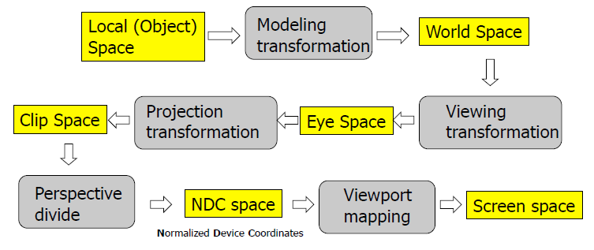
3D Computer graphics
The graphics pipeline is a series of conversions of points into different coordinate systems or spaces

Slide 15
2D SpriteBatch based graphics
Sprite data -> local space
Move based on position in the level -> world space
Move based on position with respect to camera -> screen space

Slide 16
Example (scaled)
Super Mario Bros. Level 1-1 modified from
http://ian-albert.com/games/super_mario_bros_maps/

Slide 17
Example (not scaled)

Slide 18
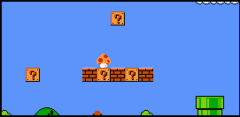
Example (windowed)
Camera’s top left corner is at (227, 57) in world space
For the leftmost question block,
Top left corner is at (256, 127) in world space
When drawn using the camera, top left corner is at (29, 70) in screen space
In general,
Screen space or position to draw = ( worldSpacePosition.x – cameraPosition.x,
worldSpacePosition.y – cameraPosition.y )

Slide 19
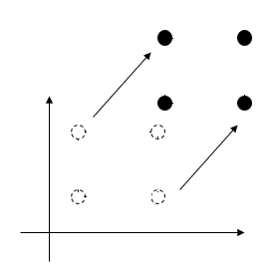
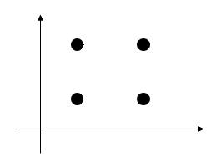
Camera logic using a transformation matrix
SpriteBatch Begin parameter: Nullable<Matrix> transformMatrix
Translation matrix: Vector3 or (x, y, z), that represents a change in drawing position by +x, +y, and +z
Translate objects along the same vector

Slide 20
Camera system design
Data could include
position, height, width
Methods could include
MoveLeft, MoveRight, MoveUp, etc.
IncreaseHeight, DecreaseWidth, etc.
May want a CameraController to determine when/how to call these methods

Slide 21
Cardinality
A standard design question is always, “How many?”
How many players?
How many cameras?
Would your code change if the answer is ever more than 1?

